Slide 1
Lecture 5
Creating Markup with XML

Slide 2
Background
XML is a technology for creating markup languages to describe data of virtually any type in a structured manner.
XML is both simplified and extended SGML.
  Complex features defined for SGML were eliminated.
  New capabilities, particularly related to datatypes were added.
  Under XML, DTDs were used initially, but have now given way to Schemas.

Slide 3
Some Milestones
October 1994 – W3C founded
November 1996 – First XML draft
1998 – XML 1.0 Recommendation, XHTML
2000 – XML 1.0 (2nd Edition) Recommendation
2001 – XML 1.1 Candidate Recommendation
2004 – XML 1.1 Recommendation
2006 – XML 1.0 (4nd Ed.), XML 1.1 (2nd Ed.)
XML 1.1 updates XML so that it no longer depends on the specific Unicode version.
You are encouraged to create or generate XML 1.0 documents if you do not need the new features in XML 1.1; XML Parsers are expected to understand both XML 1.0 and XML 1.1.
W3C Documents: Working Draft (WD) → Candidate Recommendation (CR) → Recommendation

Slide 4
First XML Example
XML declaration (processing instruction)
example1.xml
<?xml version = "1.0"?>
<!-- Simple XML document -->
<myDocument language="English">
<message>Hello, World!</message>
</myDocument>
Comment
Root element
Elements define structure; they may or may not have content.
Attributes describe elements. An element may have zero, one or more attributes placed within the start tag. Attribute values must be enclosed in quotes (single or double).

Slide 5
Well Formed XML Documents
An XML document is well formed if it is syntactically correct, i.e.
    There is a single root element.
    Each element has a start and an end tag.
    Elements are nested properly.
    Attribute values are in quotes.
XML element and attribute names are case sensitive (unlike HTML).
XML parser (or XML processor) is required to process XML documents.

Slide 6
More Markup Rules
All XML start tags must have a corresponding end tag
  Empty element in HTML
  <img src="myphoto.jpg">
  Empty element in XML
  <img src="myphoto.jpg"></img> or
  <img src="myphoto.jpg"/>
XML element and attribute names can be of any length and may contain letters, digits, underscores, hyphens and periods (and NO spaces); must begin with a letter or an underscore.
Processing instructions (PIs) are delimited by <? and ?>

Slide 7
Characters in XML Documents
Legal characters are tab (#x9), carriage return (#xD), line feed (#xA), and the legal Unicode characters
White space:
(#x20 | #x9 | #xD | #xA)+
Markup text: text enclosed in angle brackets (< and >)
Character data: any legal character except & < > ' "

Slide 8
Entity (Character) References
Built-in entities:
  &amp;
  &lt;
  &gt;
  &apos;
  &quot;
&#N; represents the Unicode character with a decimal code N
&#xM; represents the Unicode character with a hexadecimal code M
Example: To mark up the characters <>& we would write &lt;&gt;&amp;

Slide 9
Second XML Example
Processing instructions (PIs)
example2.xml
<?xml version="1.0"?>
<!-- Second XML example -->
<?xml:stylesheet type="text/xsl" href="usage.xsl"?>
<book isbn="999-99999-9-X">
<title>Deitel&apos;s XML Primer</title>
<author>
<firstName>Paul</firstName>
<lastName>Deitel</lastName>
</author>
<chapters>
<chapter num="1" pages="4">Easy XML</chapter>
<chapter num="2" pages="20">XML Elements</chapter>
</chapters>
<media type="CD"/>
</book>

Slide 10
CDATA Section
example3.xml
<?xml version="1.0"?>
<!– CDATA example -->
<cdataexample>
<sample>
// C++ comment
if (this-&gt;getX() &lt; 5 &amp;&amp; value[ 0 ] != 3 )
cerr &lt;&lt; this-&gt;displayError();
</sample>
<sample>
<![CDATA[
// C++ comment
if (this->getX() < 5 && value[ 0 ] != 3 )
cerr << this->displayError();
]]>
</sample>
</cdataexample>

Slide 11
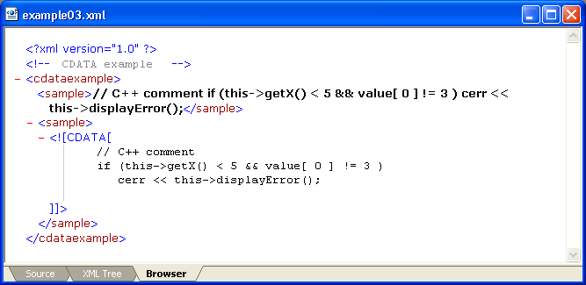
CDATA Section (contd.)
Character data in a CDATA section is NOT processed by the XML parser! CDATA can contain almost any text except ]]>

